Slide 1

Quantum Chemistry: The Hidden Rules of Atoms and Molecules
Peng Xu
May 29, 2025

Slide 2
Roadmap
Wave function
Schrödinger Equation
The Hamiltonian
Hydrogen Atom
Helium Atom
Independent Particle
Perturbation theory
Variational method
Chemical bond: LCAO-MO
Intermolecular Forces
Fragmentation approaches

Slide 3


Why Quantum Mechanics?
Quantum mechanics (QM) described the behavior of matter at the smallest scales: molecules, atoms, electrons, photons, quarks,…. Essential to the operation of modern technology.
Beautiful subject that took most of the first half of the 20th century to formulate
I think I can safely say that nobody understands quantum mechanics. So do not take the lecture too seriously… but just relax and enjoy it... Do not keep saying to yourself, if you can possibly avoid it, “But how can it be like that?” because you will get… into a blind alley from which nobody has escaped. Nobody knows how it can be like that.
The Messenger Lectures, 1964

Slide 4
1900 Planck “solves” the blackbody problem by postulating that the oscillators that emit light have quantized energy levels.
“Until after some weeks of the most strenuous work of my life, light came into the darkness, and a new undreamed-of perspective opened up before me…the whole procedure was an act of despair because a theoretical interpretation had to be found at any price, no matter how high that might be.”
1905 Einstein proposes that light energy is quantized with quanta called ”photons” - waves behave like particles
Photoelectric effect for which he got the Nobel Prize
1913 Bohr proposes that electron orbits are quantized
Idea that electrons act like waves - “explained” H atom, but wrong in crucial ways
1923 de Broglie proposes that particles behave like waves
The step that paved the way for understanding all of nature
1925-1926 Schrödinger postulate the Schrödinger equation
…

Slide 5
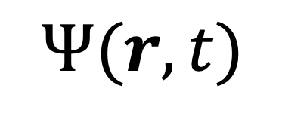
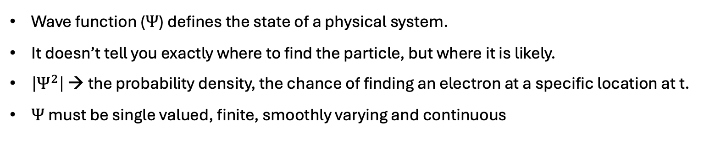
Wave Function: State Function of the Quantum Mechanical System
$$Ψ(r,t)$$
Wave function ($Ψ$) defines the state of a physical system.
It doesn’t tell you exactly where to find the particle, but where it is likely.
$\left|Ψ^{2}\right|$ → the probability density, the chance of finding an electron at a specific location at t.
$Ψ$ must be single valued, finite, smoothly varying and continuous
How do we obtain wave functions?

Slide 6
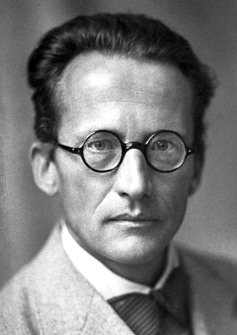
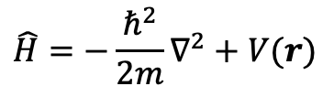
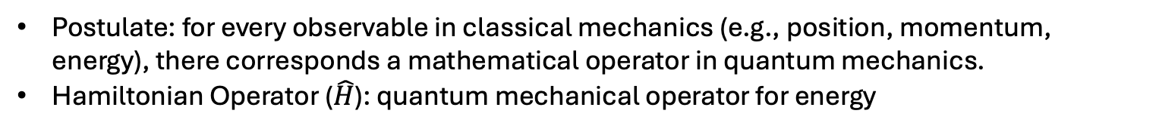
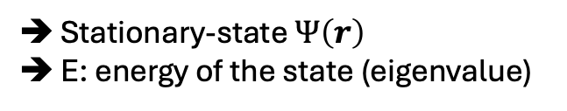
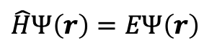
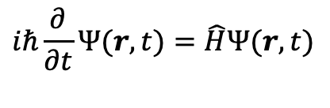
Schrödinger Equation: The Quantum Rulebook
The fundamental equation of quantum mechanics, developed (1926) by Austrian physicist, Erwin Schrödinger
Time-dependent
Time-independent
$$iℏ\frac{∂}{∂t}Ψ(r, t)=\hat{H}Ψ(r,t)$$
$$\hat{H}Ψ\left(r\right)=EΨ\left(r\right)$$
Stationary-state $Ψ\left(r\right)$
E: energy of the state (eigenvalue)
Central importance in chemistry
Postulate: for every observable in classical mechanics (e.g., position, momentum, energy), there corresponds a mathematical operator in quantum mechanics.
Hamiltonian Operator ($\hat{H}$): quantum mechanical operator for energy
$$\hat{H}=−\frac{ℏ^{2}}{2m}∇^{2}+V(r)$$
K. E.
P. E.
https://en.wikipedia.org/wiki/Erwin_Schr%C3%B6dinger
Notes:
The time dependence of wave function is governed by the TD Schrödinger equation. The wave function of a system evolves in time according to this eqn.

Slide 7
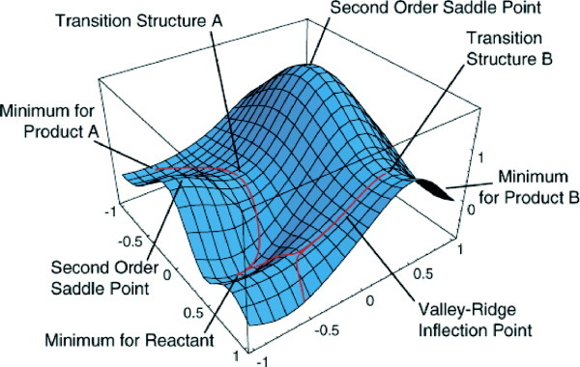
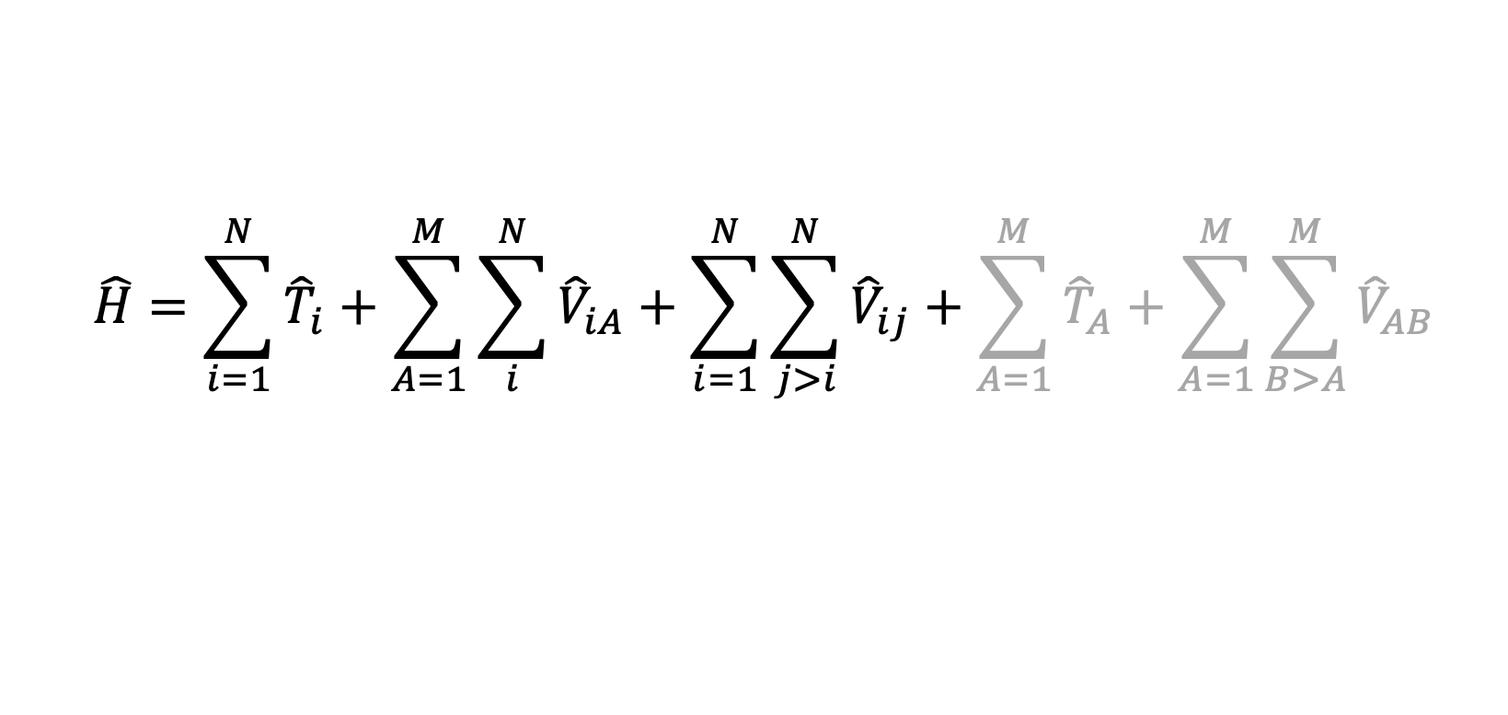
The Hamiltonian
Potential Energy Surface (PES)
The Hamiltonian in the time-independent Schrödinger equation has the following form:
$$\hat{H}=\sum_{i=1}^{N}{{\hat{T}}_{i}}+\sum_{A=1}^{M}{\sum_{i}^{N}{{\hat{V}}_{iA}}}+\sum_{i=1}^{N}{\sum_{j>i}^{N}{{\hat{V}}_{ij}}}+\sum_{A=1}^{M}{{\hat{T}}_{A}}+\sum_{A=1}^{M}{\sum_{B>A}^{M}{{\hat{V}}_{AB}}}$$
Kinetic energy operator of electron i.
Potential energy operator between nucleus A and electron i.
attractive
Potential energy operator between electrons i and j. repulsive
Born-Oppenheimer approximation: assume nuclei are massive compared to electrons
Schlegel, H. B. J. Comput. Chem. 2003, 24, 1514-1527.

Slide 8
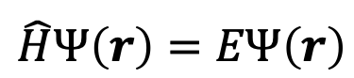
Schrödinger Equation for Chemistry Problems
Schrödinger equation is an eigenvalue equation
(Operator) eigenfunction = (eigenvalue) eigenfunction
Our objective is to solve the Schröndinger equation for chemistry problems (atoms, molecules ..)
Analytic solution only for H atom (1 electron system or hydrogen-like system)
Not possible for anything with > 1 electrons ➔ Solution: introduce approximations
Orbitals: one-electron wave function
$$\hat{H}Ψ\left(r\right)=EΨ\left(r\right)$$

Slide 9
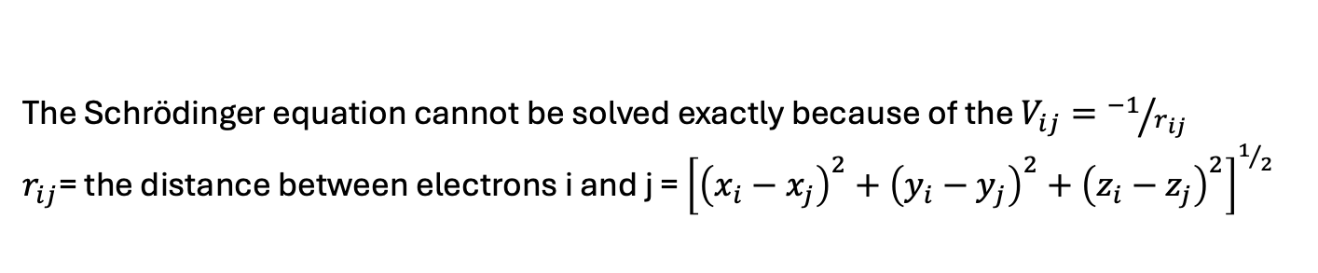
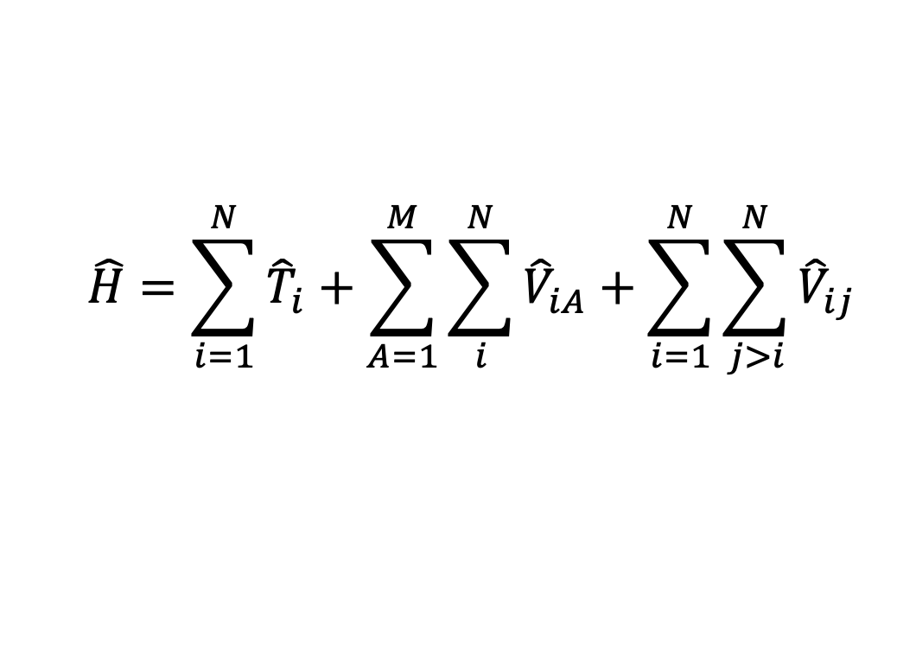
The Roadblock
$$\hat{H}=\sum_{i=1}^{N}{{\hat{T}}_{i}}+\sum_{A=1}^{M}{\sum_{i}^{N}{{\hat{V}}_{iA}}}+\sum_{i=1}^{N}{\sum_{j>i}^{N}{{\hat{V}}_{ij}}}$$
The Schrödinger equation cannot be solved exactly because of the $V_{ij}={−1}/{r_{ij}}$
$r_{ij}$= the distance between electrons i and j = ${\left[{\left(x_{i}−x_{j}\right)}^{2}+{\left(y_{i}−y_{j}\right)}^{2}+{\left(z_{i}−z_{j}\right)}^{2}\right]}^{1/2}$
Not separable → the many-body problem

Slide 10
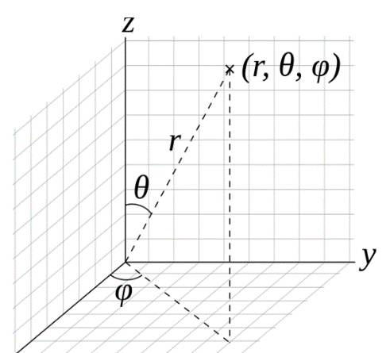

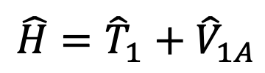
Hydrogen Atom: can be solved exactly
$$\hat{H}={\hat{T}}_{1}+{\hat{V}}_{1A}$$
Only one electron → No $V_{ij}$ term
The wave function solution to the Schrödinger equation for the hydrogen atom defining the orbitals is given by (in spherical polar coordinates):
Eigenfunction:
Radial function
Spherical harmonics
n=1,2,3… Principal quantum number
l=0,1,2…n-1 Angular quantum number
|m|≤l Magnetic quantum number
R determines the size/extent of the wave function
Y determines the shape: s, p, d, …

Slide 11
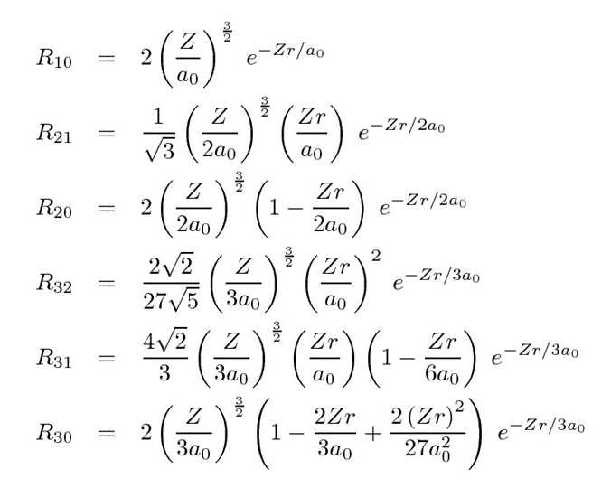
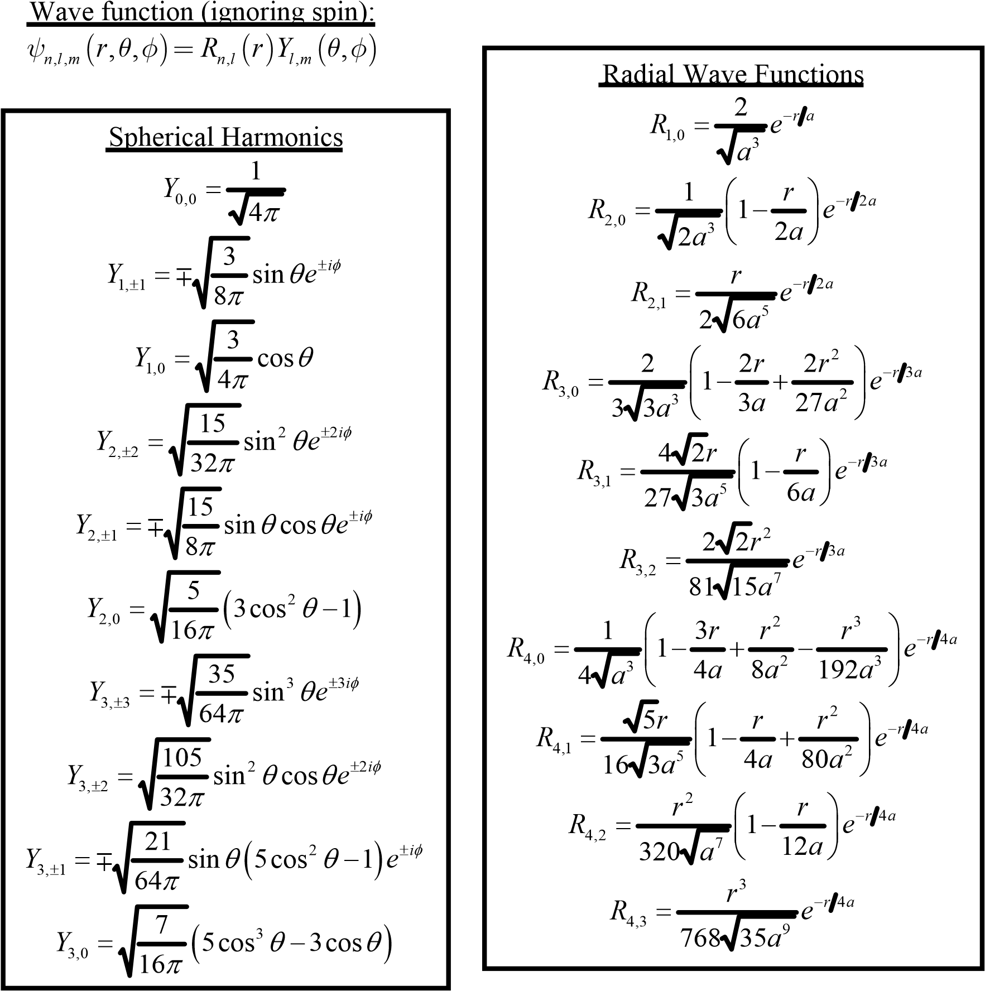
Radial Function and Spherical Harmonics
Note: a₀ = 1 in atomic units

Slide 12
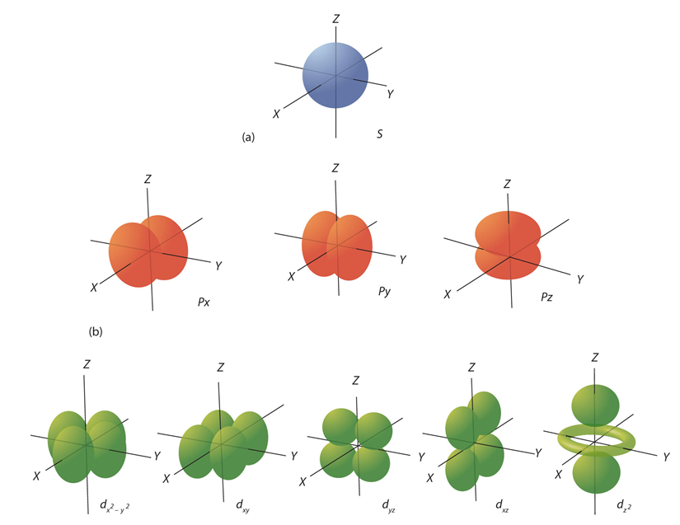
Atomic Orbitals: One-Electron Wave Functions
s orbital
One-electron wave function solution to the Schrödinger equation for a single electron
energy, shape, and orientation of an electron’s “probability cloud”
Spherical harmonics are complex. In order to work with real functions, we take linear combinations of the complex spherical harmonics.
p orbitals
d orbitals

Slide 13
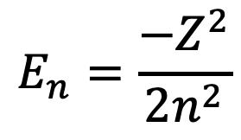
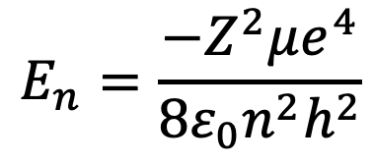
Hydrogen Atom Energy Levels
In SI units, The energy levels of the hydrogen atom are given by:
Z= Number of protons in the nucleus
µ= reduced mass (kg): m_{e}m_{p}/(m_{e}+m_{p})
e= charge of the proton (C)
n= principal quantum number
h= Plank’s constant (J.s)
ε₀=permittivity (C².N⁻¹.m⁻²)
$$E_{n}=\frac{−Z^{2}μe^{4}}{8ε_{0}n^{2}h^{2}}$$
In atomic units, the energy levels of the hydrogen atom are given by:
$$E_{n}=\frac{−Z^{2}}{2n^{2}}$$
Note: The energy depends on n only. Not on l and m. Therefore, states with the same n and different l and m (i.e., 2s and 2p) are degenerate. This degeneracy is partly lifted for many-electron atoms

Slide 14
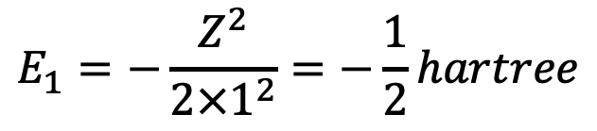
H Atom: Ground State Energy
For ground state, n = 1
$$E_{1}=−\frac{Z^{2}}{2×1^{2}}=−\frac{1}{2}hartree$$
Units: 1 hartree = 27.21 eV = 627.5 kcal/mol
E_{n} = -1/2 h = -13.6 eV = -313.76 kcal/mol
So, first ionization potential (IP) for H = 13.6 eV
How do we deal with heavier atoms?

Slide 15
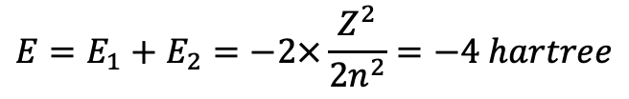
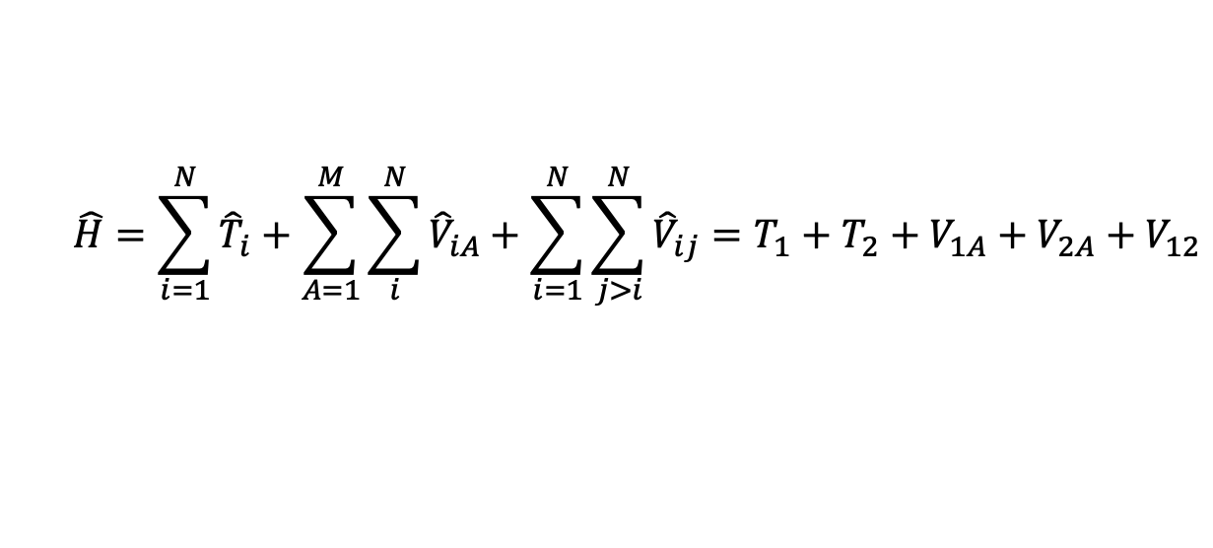
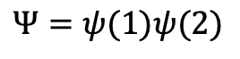
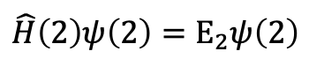
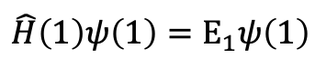
Helium Atom: Independent Particle
N = 2 (electrons)
$$\hat{H}=\sum_{i=1}^{N}{{\hat{T}}_{i}}+\sum_{A=1}^{M}{\sum_{i}^{N}{{\hat{V}}_{iA}}}+\sum_{i=1}^{N}{\sum_{j>i}^{N}{{\hat{V}}_{ij}}}=T_{1}+T_{2}+V_{1A}+V_{2A}+V_{12}$$
Cannot solve SE exactly due to the electron repulsion term in the Hamiltonian → many-body problem
Independent particle model: Can we ignore the electron repulsion?
$$\hat{H}=\left(T_{1}+V_{1A}\right)+\left(T_{2}+V_{2A}\right)=H_{1}^{(0)}+H_{2}^{(0)}=H^{(0)}$$
This Hamiltonian is the sum of two hydrogen-like Hamiltonians that we can solve exactly and separately:
$$\hat{H}\left(1\right)ψ\left(1\right)=E_{1}ψ\left(1\right)$$
$$Ψ=ψ(1)ψ(2)$$
Experimental: -2.905 Hartree
~ 1.1 Hartree error = 687 kcal/mol
Energy is too low due to neglecting electron repulsion
$$\hat{H}\left(2\right)ψ\left(2\right)=E_{2}ψ\left(2\right)$$
$$E=E_{1}+E_{2}=−2×\frac{Z^{2}}{2n^{2}}=−4 hartree$$
Z=2 for helium

Slide 16
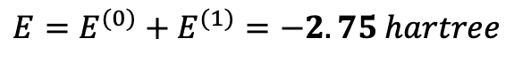
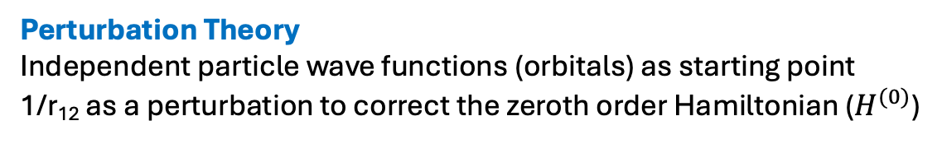
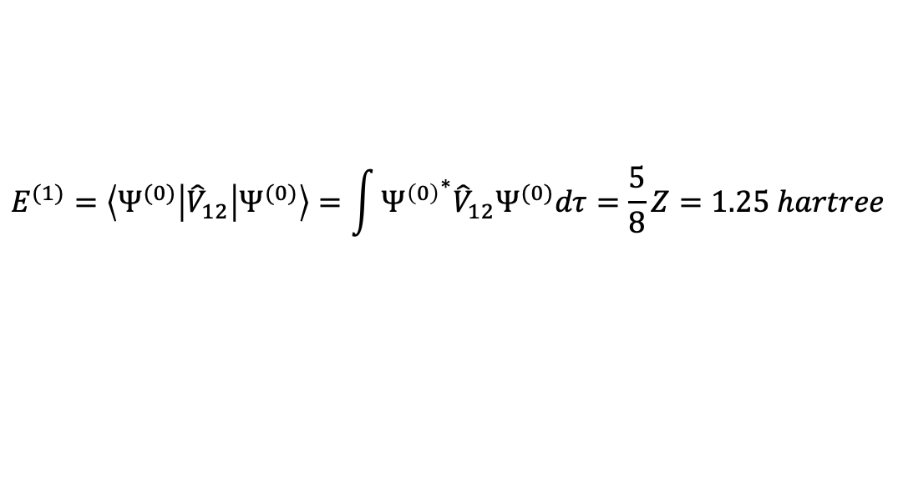
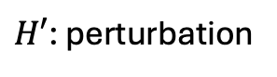
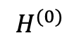
Helium Atom: Perturbation Theory
Perturbation Theory
Independent particle wave functions (orbitals) as starting point
1/r₁₂ as a perturbation to correct the zeroth order Hamiltonian ($H^{(0)}$)
$$\hat{H}=T_{1}+T_{2}+V_{1A}+V_{2A}+V_{12}$$
$$H^{(0)}$$
$H′$: perturbation
Using perturbation theory, the first-order correction to the energy is:
$$E^{(1)}=\left\langle Ψ^{(0)} | {\hat{V}}_{12} | Ψ^{(0)}\right\rangle =\int{{Ψ^{\left(0\right)}}^{∗}{\hat{V}}_{12}Ψ^{(0)}dτ}=\frac{5}{8}Z=1.25 hartree$$
$$E=E^{(0)}+E^{(1)}=−2.75 hartree$$
→ Better than the independent particle model
Experimental: -2.905 Hartree

Slide 17
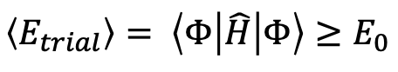
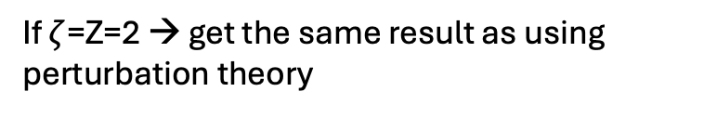
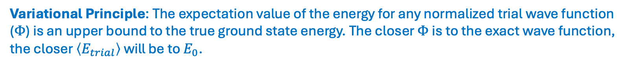
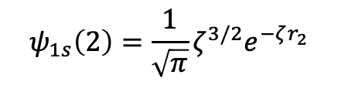
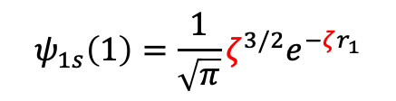
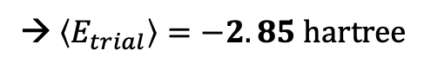
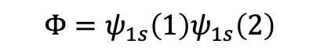
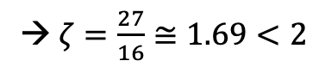
Helium Atom: Variational Method
Variational Principle: The expectation value of the energy for any normalized trial wave function ($Φ$) is an upper bound to the true ground state energy. The closer $Φ$ is to the exact wave function, the closer $\left\langle E_{trial}\right\rangle$ will be to $E_{0}$.
$$\left\langle E_{trial}\right\rangle = \left\langle Φ | \hat{H} | Φ\right\rangle ≥E_{0}$$
Need a trial wave function for He. Where do we get one?
So far, all we know is the orbitals from the independent particle model, may as well try it.
If $ζ$=Z=2 → get the same result as using perturbation theory
$$Φ=ψ_{1s}\left(1\right)ψ_{1s}\left(2\right)$$
Effective atomic number:
Variational parameter
$$ψ_{1s}\left(1\right)=\frac{1}{\sqrt{π}}ζ^{3/2}e^{−ζr_{1}}$$
Want to find the value of $ζ$ to give the lowest energy
→ $ζ=\frac{27}{16}≅1.69<2$
$$ψ_{1s}\left(2\right)=\frac{1}{\sqrt{π}}ζ^{3/2}e^{−ζr_{2}}$$
Each electron partially screens the nucleus from the other so that the net effective nuclear charge is reduced from 2 to 27/16
Experimental: -2.905 Hartree
→ $\left\langle E_{trial}\right\rangle =−2.85 hartree$

Slide 18
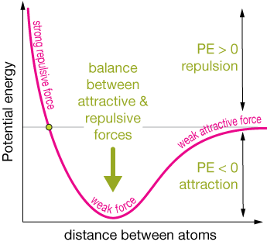
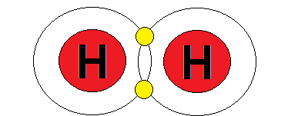
Chemical Bond: Quantum Glue
http://xaktly.com/ConservationThermo.html

Slide 19
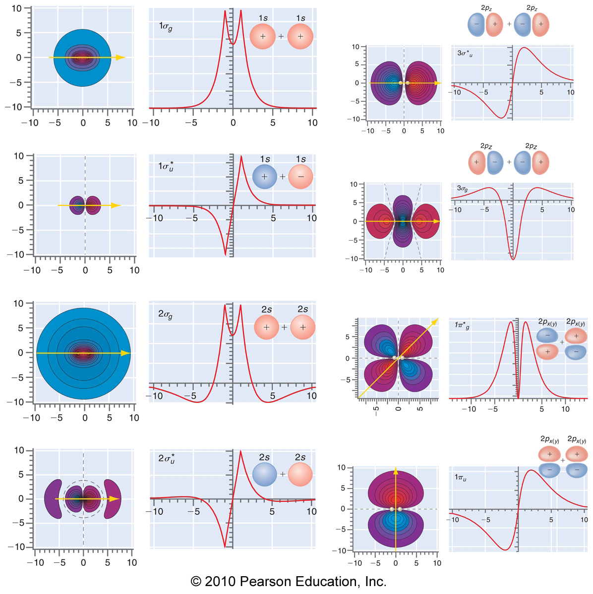
Linear Combination of Atomic Orbitals for Molecular Orbitals (LCAO-MO)
BONDING
ANTIBONDING

Slide 20
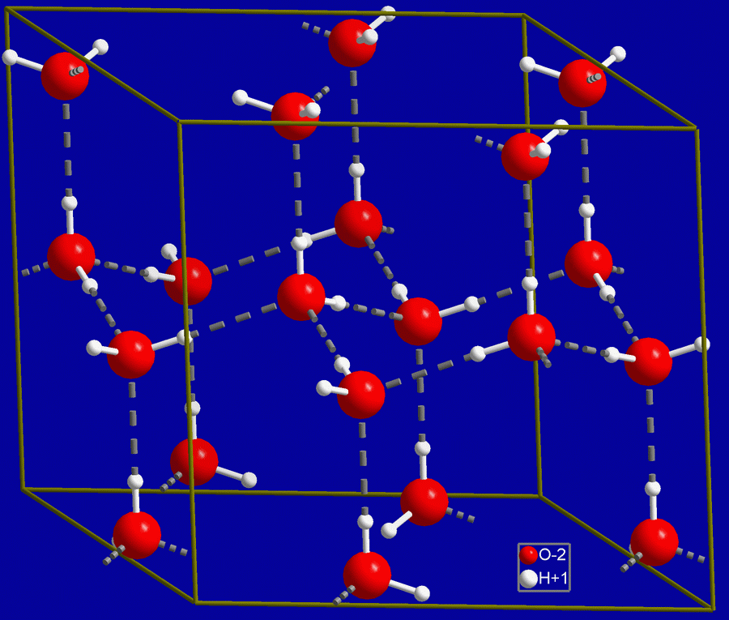
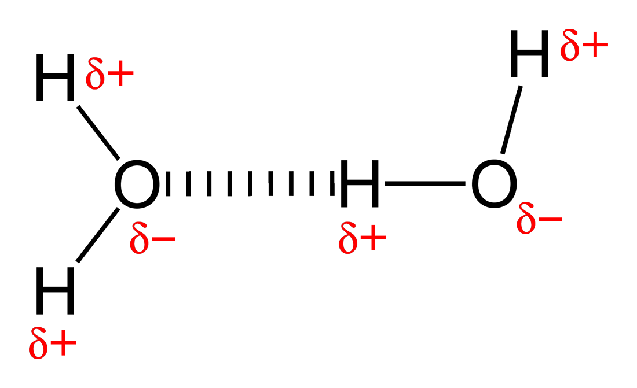
Intermolecular Forces
Orders of magnitudes smaller than typical chemical bonds
Coulomb interactions
Polarization/Induction: e.g., dipole-dipole interactions between polar molecules
Dispersion/Van der Waals: e.g., induced dipole-induced dipole interactions
Exchange repulsion: a purely quantum mechanical effects
Hydrogen Bond
https://commons.wikimedia.org/wiki/File:Hydrogen-bonding-in-water-2D.png
https://commons.wikimedia.org/wiki/File:Hex_ice.GIF

Slide 21
Ab Initial Quantum Chemistry Methods
Computational techniques that are based on quantum chemistry that aim to solve the electronic SE.
Ab initio: “from first principles”, only use physical constants and positions of electrons etc as input.
Increased sophistication of methods to approach exact solution to the electronic Schrödinger equation
Formal scaling of methods based on system size, N (e.g., number of basis functions)
Scaling Behavior | Method
N⁴ | Hartree-Fock (HF), hybrid Density Function Theory (DFT) | Up to ~1000 atoms
N⁵ | Møller-Plesset Second-Order Perturbation Theory (MP2) | Up to ~ 100 atoms
N⁷ | Coupled-Cluster with Singles and Doubles and Perturbative Triples excitations (CCSD(T)) | Up to ~ 10-20 atoms
N⁸ | Coupled-Cluster with Singles and Doubles and Triples excitations (CCSDT) | < 10 atoms
N! | Full Configuration-Interaction (Full-CI) | Diatomics
Dynamic correlation required to capture weak non-covalent interactions like van der Waals
Exact Solution

Slide 22
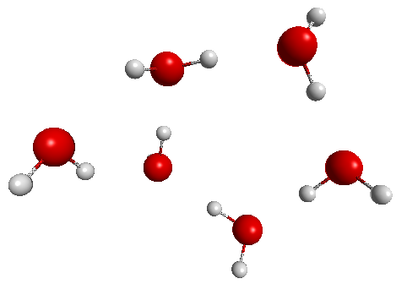
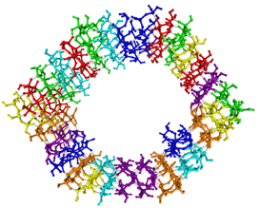
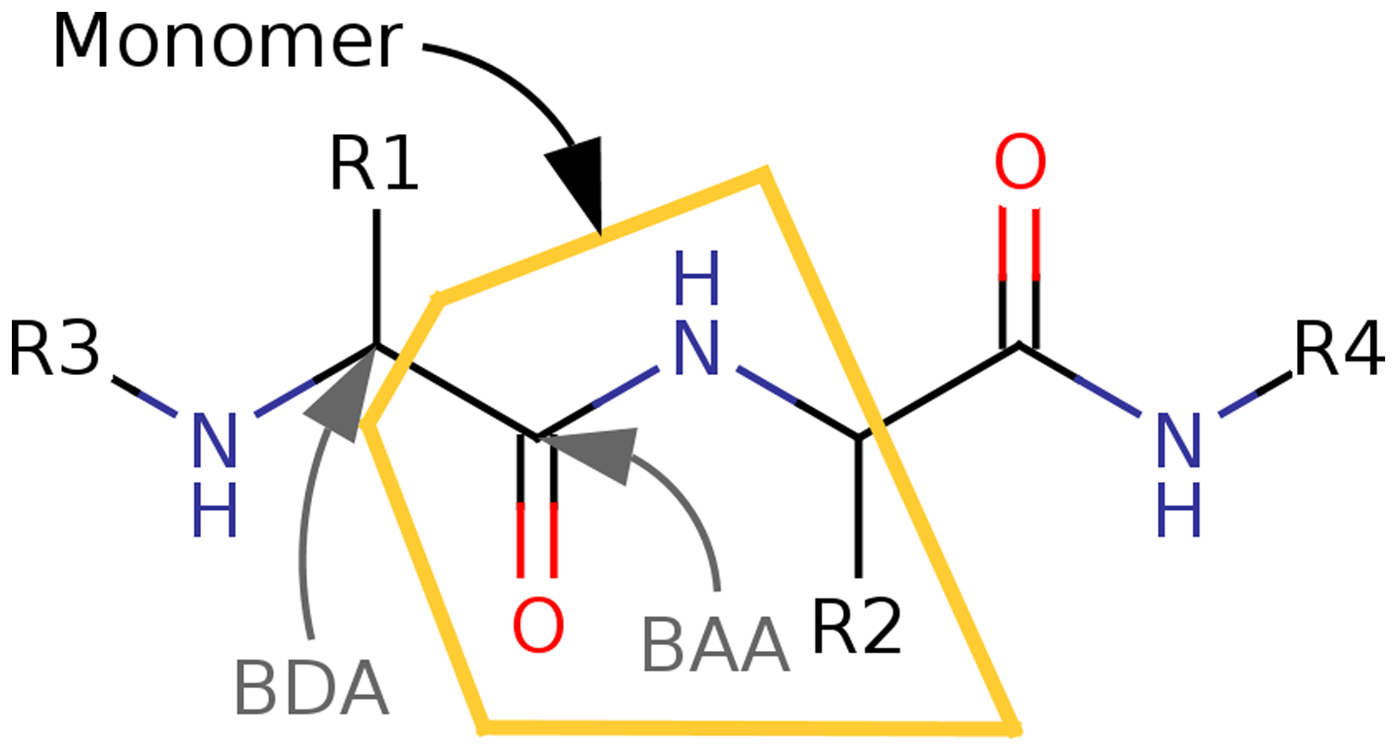
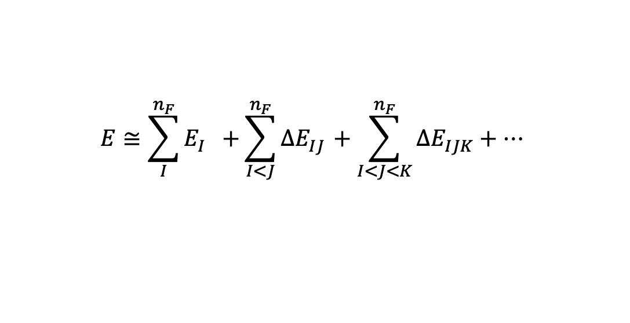
Fragmentation Methods
Effective fragment potential (EFP)
Fragment molecular orbital (FMO)
Effective fragment molecular orbital (EFMO)
A QM-based force field
Designed to model solvent effects
Noncovalent interactions
Internally Rigid fragments
partition system into smaller pieces
Ab initio method based on many-body expansion
Flexible fragments
Merger of EFP and FMO
Simplifies FMO and improves accuracy
Ab initio method
Flexible fragments
$$E≅\sum_{I}^{n_{F}}{E_{I}^{}+}\sum_{I<J}^{n_{F}}{ΔE_{IJ}^{}}+\sum_{I<J<K}^{n_{F}}{ΔE_{IJK}^{}}+…$$

Slide 23
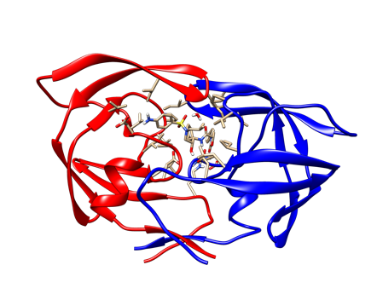
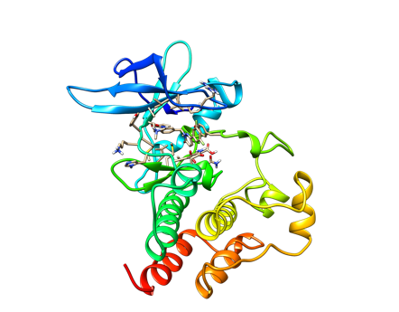




Applications of Quantum Chemistry
Protein-Ligand
Host-Guest
Mesoporous silica nanoparticles (MSNs)

Slide 24

Summary
$$\hat{H}Ψ\left(r\right)=EΨ\left(r\right)$$

